Slide 1
Tec de Monterrey Hello Robot KeyPrediction
Practice 2: Stretch
Robot Kinematics
Velocity, States, and Command Blending

Slide 2




Tec de Monterrey KeyPrediction
Environment Setup & Updates
1. Update Repository
2. Sync Dependencies
Pull recent improvements. Warning: Overwrites local changes.
Ensure packages match specifications securely:

Slide 3
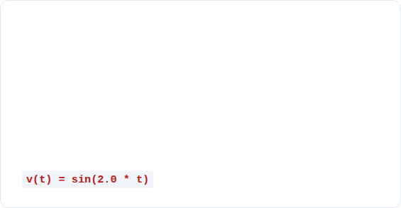

Hello Robot KeyPrediction
Velocity Control & Joint States
Part 1: Velocity Control
Part 2: Reading State
Command normalized joint speeds via controller.set_velocities().
Retrieve live position metrics with controller.get_state().
Task: Create p2_1_velocity.py to oscillate head pan using a sine wave:
Task: Create p2_2_state.py to print joint frames dynamically (Linear = meters, Rotational = radians).

Slide 4


Tec de Monterrey Hello Robot
Position Control & Input Devices
Part 3: Position Bouncing
Part 4: Unified Inputs
Use StateController to generate targeted velocity adjustments natively.
The stretch_toolkit.input abstraction maps hardware universally.
Task: Make the arm bounce continuously between 0.1 m and 0.3 m in p2_3_position.py.
• is_pressed("button"): Digital fallback
• get_axis("RX"): Analog stick scaling
• rising_edge("A"): One-shot frames

Slide 5


KeyPrediction Hello Robot
Command Layering & Override
Proportional Blending
The Y Toggle Mode
merge_proportional() combines manual and autonomous commands dynamically.
teleop.get_manual_override() manages full controls. Press Y / y to swap:
Under a 0.05 deadband, autonomy rules; outside it, human inputs smoothly blend and override.

Slide 6

Tec de Monterrey Hello Robot KeyPrediction
Submission Checklist
Video File Requirements (30-60 Seconds)
Your video submission must clearly demonstrate:
1. Arm bouncing autonomously (0.1m to 0.3m)
2. Proportional human override during active bounce
3. Pressing Y key to transition into total MANUAL mode
4. Pressing Y again to resume target AUTONOMOUS loop

